Slide 1


EDUFIRST
WORKSHOP
21.5.2025

Slide 2

Introduction
Who is present today?
Tell us about your:
Name and role
Professional background

Slide 3
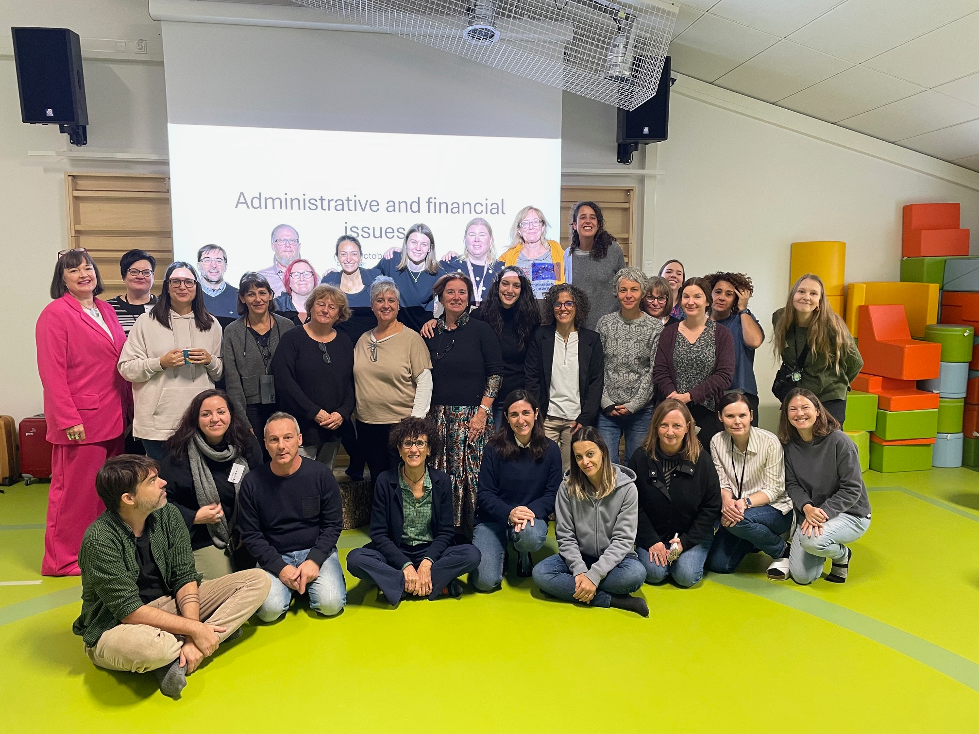

Background of the EduFirst project
EDUFIRST: Improving Early Childhood Education and Care services (ECEC) for inclusion, equity, community participation and climate justice
EDUFIRST aims to support municipalities in improving the early childhood education and care (ECEC) service system
EDUFIST aims at supporting the collaborative efforts of municipalities to improve their ECEC services system
It involves the large experience and knowledge of three big, non-capital, European cities (Barcelona, Milano and Tampere) and UVIC
Partners aim to address a set of common challenges related to the availability (equality of the offer), accessibility (barriers to diversity) and quality of ECEC services, all oriented to reach the EU Child Guarantee at the local level
We are jointly working on an international book project in which the Tampere chapters address multilingualism, multiculturalism, and quality assessment in early childhood education

Slide 4
Instructions
The main objective of the workshop is to envision better early childhood education and care services at the European level
In what ways could early childhood education and care services be improved for all European cities, children, families, and educators?
The aim of the workshop is to gather participants’ perspectives and comparisons on how current early childhood education and care services can be enhanced and to establish proposals for new ECEC services

Slide 5
Part 1- New Model for
ECEC Services in Europe

Slide 6

Key challenges of ECEC services in Europe
Universal access to early childhood education and care services for all children, especially during the first 1,000 days of life
Increasing diversity and inequality among children and families
New perspectives on the quality of early childhood education and care services in today’s context
Current and future core functions of early childhood education and care services: care, education, work–family balance, reduction of inequality, and social and linguistic inclusion
Dialogue between policy, institutional levels, and pedagogy
Teacher shortages, social recognition, and working conditions

Slide 7
New Model for ECEC Services in Europe
Individual work, questions to answer:
How can European cities overcome the educator's shortage? Which measures could be more effective?
How can the political level (policymakers), the institutional level (kindergarten, family space, home-based services…) and the pedagogical/care level (everyday practices) be more connected and be more coherent?
What does it mean for you that ECEC services are a common good, that is “places to produce social relations of cooperation and co-implication”?
Should all ECEC services have a clear, well-structured, global and common model? Or should ECEC services be more open, contextualized and responsive to local realities? Why?
How do you think ECEC services in Europe could look like to face current challenges?
How better ECEC services for the future could look like?
Thoughts are gathered into Padlet: https://padlet.com/unisk/edufirst-uyam41g1osibodc0

Slide 8
Group discussion
Each participant presents their responses
Recording key reflections, ideas, and proposals
Answering 2 main questions together:
How do you think ECEC services in Europe could look like to face current challenges?
How better ECEC services for the future could look like?
The facilitator gathers the key discussion points into a summary

Slide 9
Part 2- Exploring the Potential of a Self-Evaluation Tool for ECEC

Slide 10
Self-Evaluation Tool
To support ECEC services in continuously improving their quality, the EDUFIRST project proposes the development of a Self-Evaluation tool that could guide services in identifying and addressing their needs
Individual work, questions to answer:
Which dimensions should the Self-Evaluation tool have (policy, institutional, pedagogical, job conditions, etc.)
How is the best way educators can evaluate themselves using the tool: by rubrics? By numbers? By check-list? By other methods?
How do you imagine the structure of the Self-evaluation tool? How can be organised and used to be really useful in ECEC services everyday life?
How do you think a Self-Evaluation tool for European ECEC services could be useful? How could it look like?
Thoughts are gathered into Padlet: https://padlet.com/unisk/edufirst-uyam41g1osibodc0

Slide 11
Group discussion
Each participant presents their responses
Recording key reflections, ideas, and proposals
Answering two questions together:
How do you think a Self-Evaluation tool for European ECEC services could be useful? How could it look like?
The facilitator gathers the key discussion points into a summary

Slide 12

Thank you!

